Slide 1
Explorys Most Interesting Patient:
The Health Effects of Spaceflight
Frankie Zeager, Lin Li, Yuchen Li
Sep 6, 2017

Slide 2
Spaceflight-related Medical Issues
Bone Density Loss
Without gravity's effects on your body, bones can lose minerals at a rate of up to 1% of bone mass a month
In comparison, the average elderly human on Earth loses bone mass at a rate of 1% a year
Muscle Atrophy
Without gravity, it takes much less effort to move through space, causing muscle atrophy
Cardiovascular Issues
Without gravity, a lack of intense exercise causes cardiovascular deconditioning
Source: NASA https://www.nasa.gov/hrp/bodyinspace

Slide 3
Spaceflight-related Medical Issues (cont'd)
Mental Health
Isolation in a tiny, cramped space for an extended period of time has been found to lead to mental health disorders such as depression in astronauts
Red Blood Cells
Destruction of red blood cells often occur during space travel, leading to anemia
Balance Control
The transition from weightlessness to gravity on Earth can cause balance issues and even motion sickness among astronauts
Source: NASA https://www.nasa.gov/hrp/bodyinspace and https://www.nasa.gov/mission_pages/station/research/experiments/84.html and https://www.nasa.gov/content/walk-the-line-nasa-studies-physical-performance-after-spaceflight

Slide 4
Patient Information
Born in 1940s
Caucasian
Medicare
SNOMED code of ‘Prolonged Stay in a Weightless Environment’
Notes:
Due to medical privacy concerns, we're not going to release information about gender and exact age, as these patients are too easy to de-identify

Slide 5
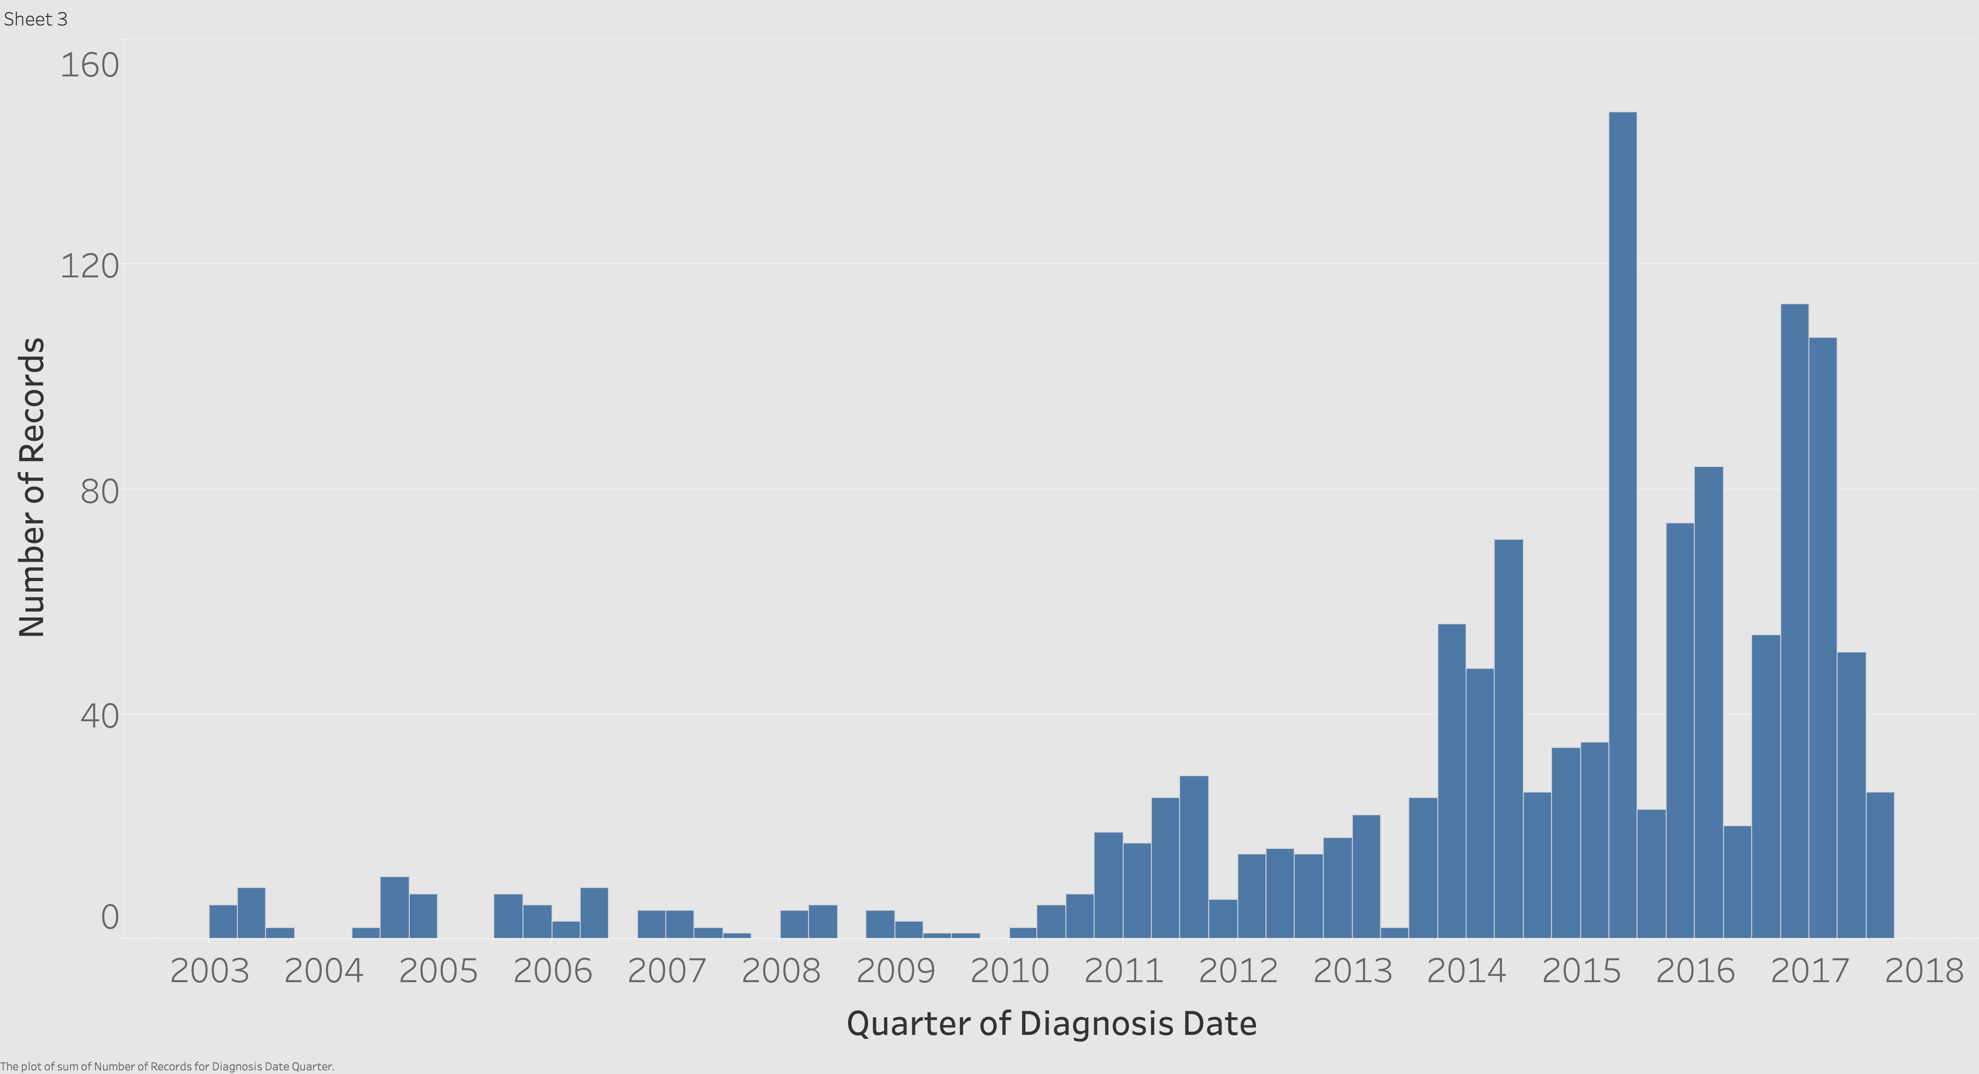
Diagnosis

Slide 6
Disease grouping

Slide 7
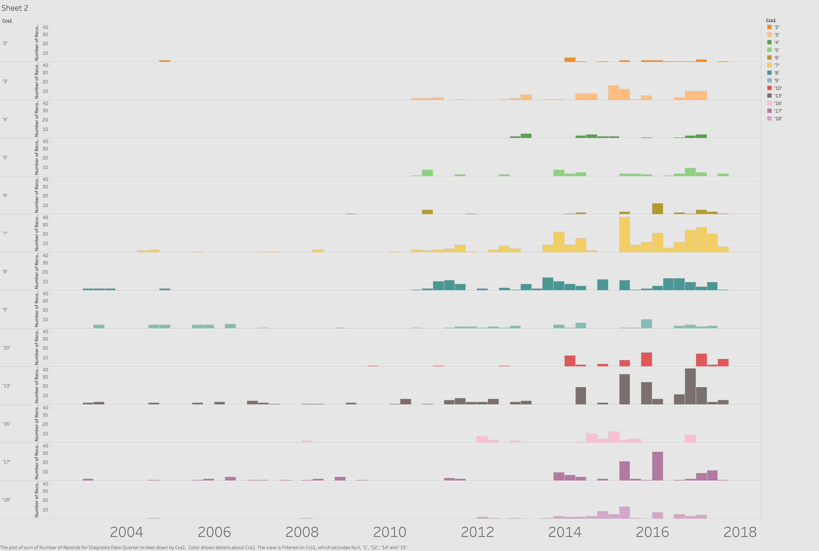
Cancer
Immunity disorders
Blood and blood-forming organs
Mental Illness
Nervous system
Circulatory system
Respiratory system
Digestive system
Genitourinary system
Musculoskeletal system
Injury and poisoning
Ill-defined conditions
Unclassified

Slide 8
Mental health
Nicotine +Opioid dependence
Tobacco use
Nicotine +Opioid dependence
Tobacco use
Major depressive disorder
Major depressive disorder
Counts
Major depressive disorder
Dementia+ Delirium
Anxiety state
Anxiety state
Suicidal ideation

Slide 9
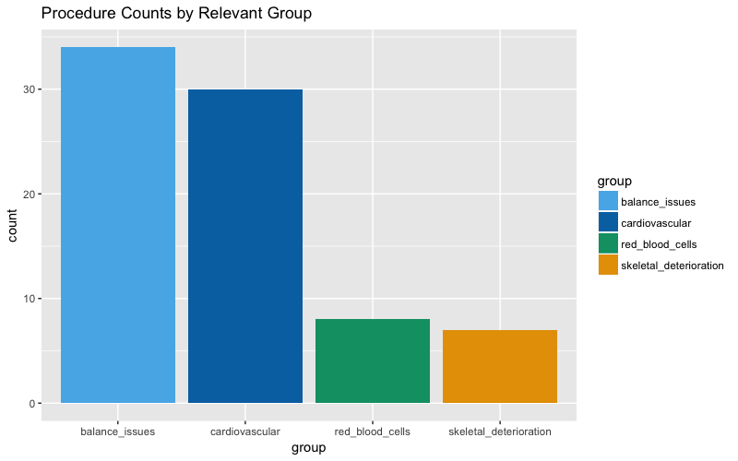
Procedure Counts by Relevant Group
e.g. Red blood cell morphology observation
e.g. Fall Risk Assessments, as early as 2009

Slide 10
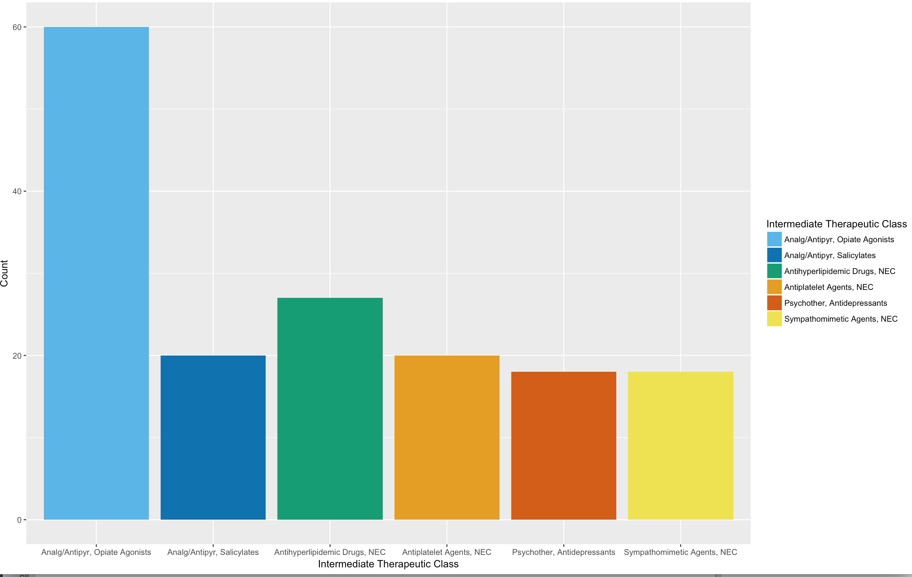
Drug Counts by Group (Top 6)

Slide 11
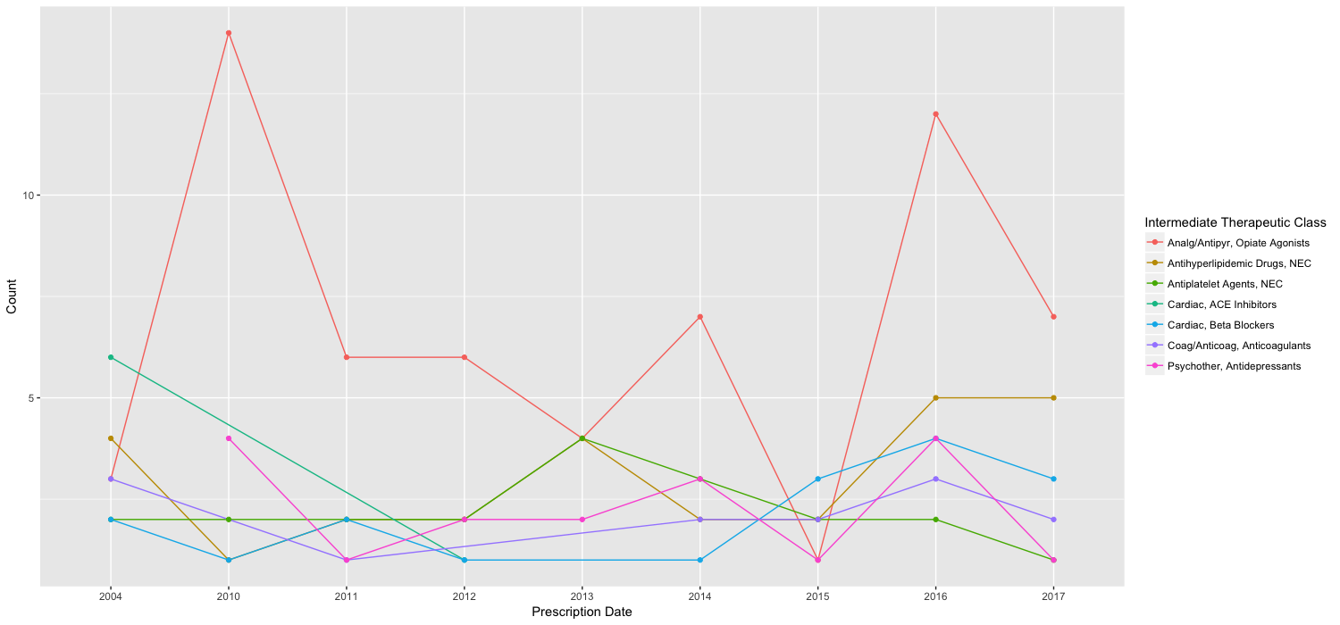
Prescriptions over Time
2004 2011 2014
First pain diagnosis
First of 23 EKGs
Coronary arteriography
Disorder of the bone/cartilage diagnosis

Slide 12
Observation
140 total tests conducted
Heart rate (934 times)
Respiration rate (804 times; breaths/min)
Systolic blood pressure (703 times)
Diastolic blood pressure (684 times)

Slide 13
Heart rate

Slide 14
Respiration rate

Slide 15
Blood pressure (Systolic)

Slide 16
Blood pressure (Diastolic)

Slide 17
Considering her conditions,
is the use of the ED
appropriate
?

Slide 18
Introduction: NYU ED Algorithm
p3
Appropriate use
p4
p2
ICD-9/10
at discharge
p1
Classify ED utilization
https://wagner.nyu.edu/faculty/billings/nyued-background
Notes:
Inputs: initial complaint, presenting symptoms, vital signs, medical history, age, gender, diagnoses, procedures performed, and resources used in the ED.
Non-emergent - The patient's initial complaint, presenting symptoms, vital signs, medical history, and age indicated that immediate medical care was not required within 12 hours;
Emergent/Primary Care Treatable - Based on information in the record, treatment was required within 12 hours, but care could have been provided effectively and safely in a primary care setting. The complaint did not require continuous observation, and no procedures were performed or resources used that are not available in a primary care setting (e.g., CAT scan or certain lab tests);
Emergent - ED Care Needed - Preventable/Avoidable - Emergency department care was required based on the complaint or procedures performed/resources used, but the emergent nature of the condition was potentially preventable/avoidable if timely and effective ambulatory care had been received during the episode of illness (e.g., the flare-ups of asthma, diabetes, congestive heart failure, etc.); and
Emergent - ED Care Needed - Not Preventable/Avoidable - Emergency department care was required and ambulatory care treatment could not have prevented the condition (e.g., trauma, appendicitis, myocardial infarction, etc.).

Slide 19
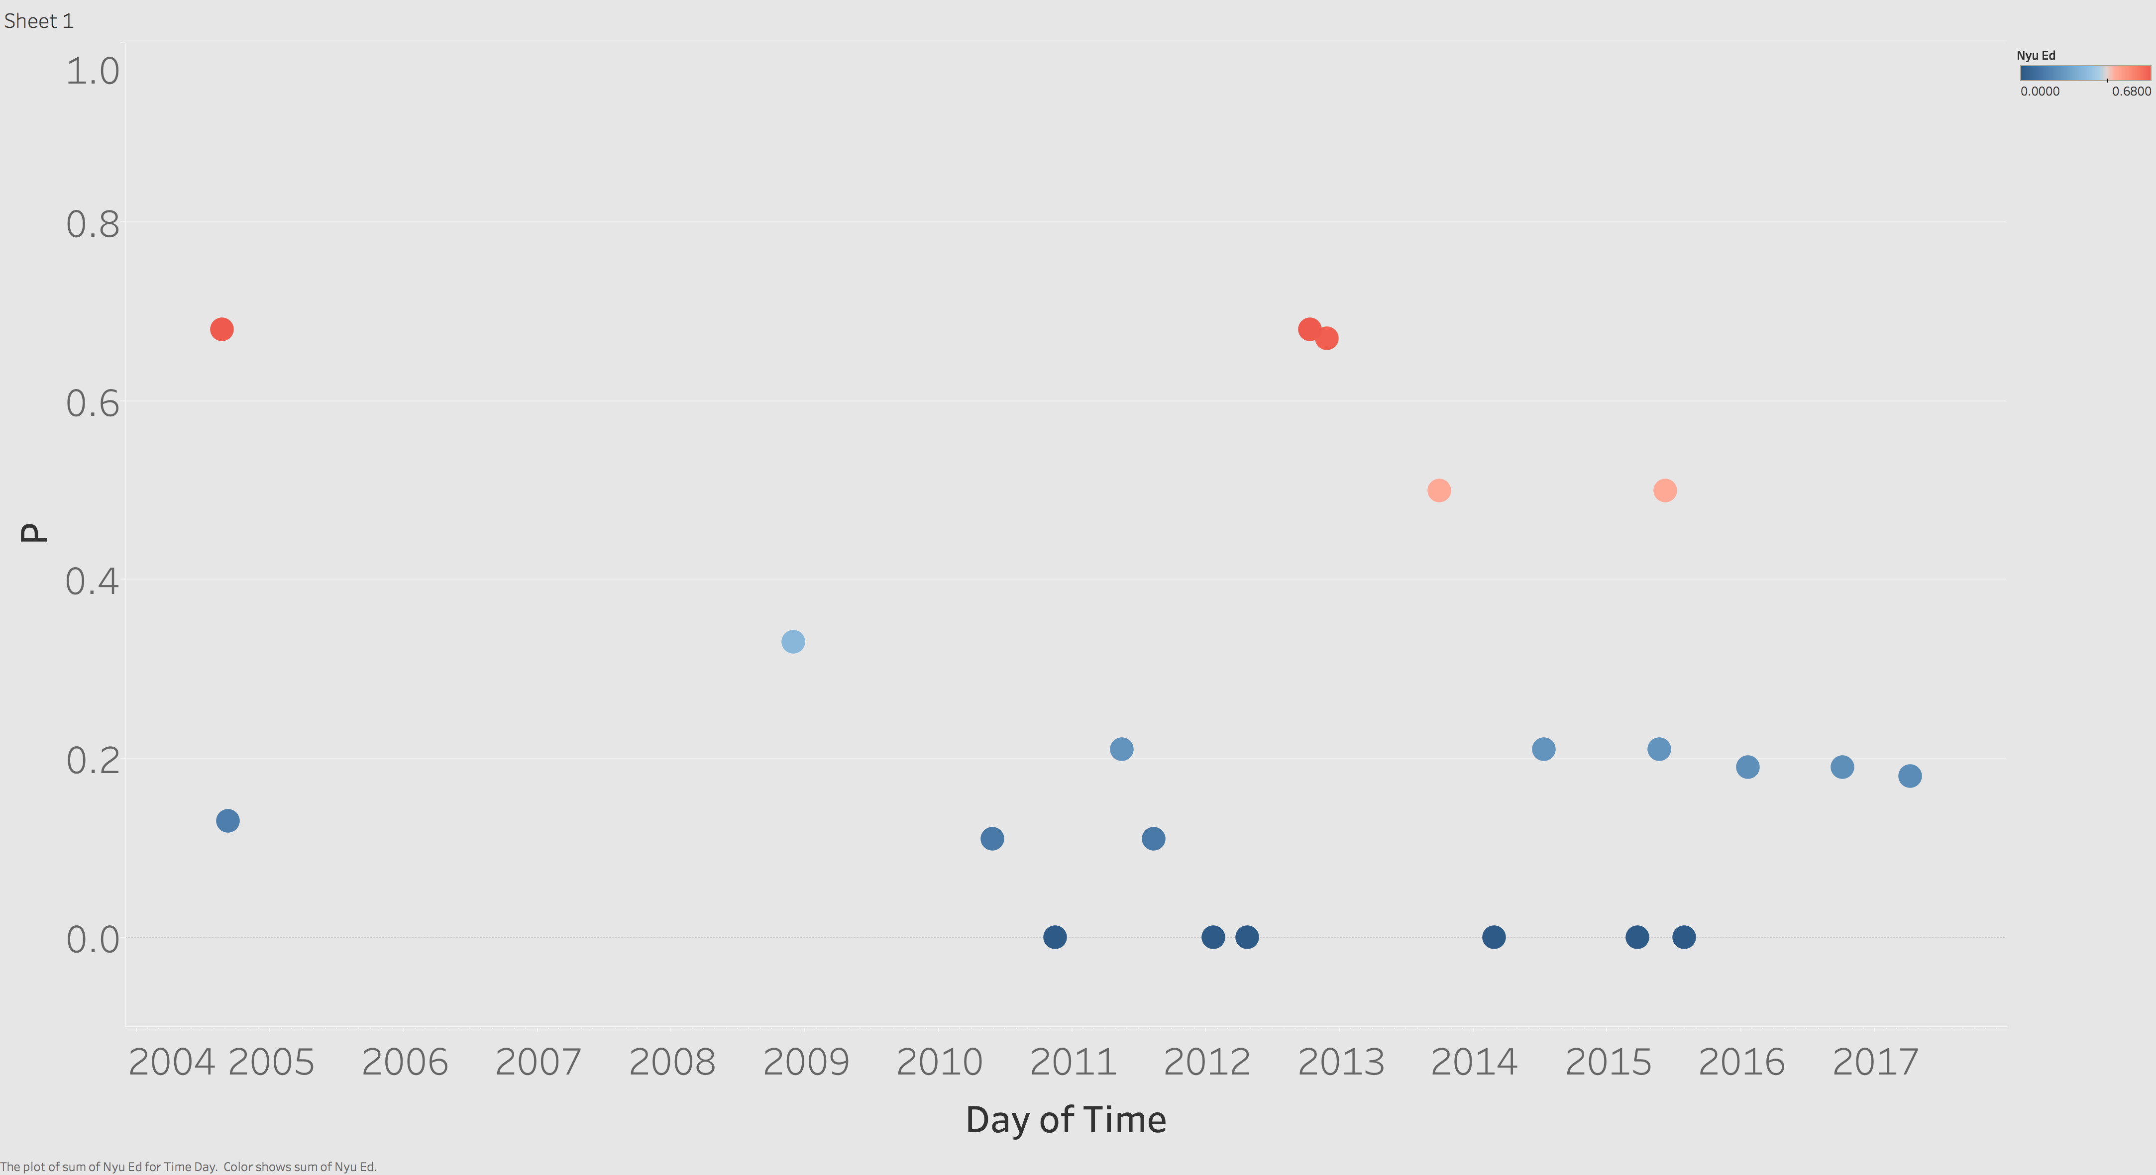
Chest pain
Chest pain
Head injury
Chronic airway obstruction
Unspecified fall
caused by hypertension
Chronic pain

Slide 20
Questions?

